Slide 1
A Case Report: Inverted Papilloma
Dr. Sayali B. Goregaonkar
Junior resident 3
Dept Of E.N.T and
Head and Neck Surgery

Slide 2
Case Report
A 62-year-old male patient came to the Out patient Department of ENT
Chief complaint of mass in right nasal cavity since 6 years and nasal obstruction since 2 years .
The patient first noticed the swelling 6 years back which had gradually progressed to the present size.
Also complaints of nasal obstruction which was insidious in onset and gradually progressed. No aggravating or relieving factors.
History of recurrent headache which was relieved temporarily after medication

Slide 3
Case Report
No history of recurrent URTI
No history of allergic symptoms
No history suggestive of post nasal drip
No history of Epistaxis
No history of facial swelling
No history of aural complaints

Slide 4
Past History:
No history of Tuberculosis or major surgical illness in the past.
Family History: Not Significant
Personal History: Not significant
General examination: Conscious, Co-operative
Systemic examination: Within Normal Limit

Slide 5
Local examination:
Nose:
External Deformity: No external deformity
Osteocartilagenous framework: Normal
Columella: Normal
Vestibule: Normal
Anterior Rhinoscopy: A pinkish mass seen occupying whole of right anterior choana pushing septum to opposite side. Surface of mass appears smooth, no discharge, no visible pulsations. Floor of nose appears free from mass. Nasal mucosa, Inferior turbinate cannot be visualised on right side. Left nasal cavity appears normal.

Slide 6
Local examination:
Nose:
Probe test: Probe can be passed medially, inferiorly, but cannot be passed supero-laterally. Mass is non tender, did not bleed on touch and firm in consistency.
Posterior Rhinoscopy: Within normal limit
Paranasal sinus examination: Tenderness present over right maxillary sinus
Ear: Within normal limit
Throat: Within normal limit

Slide 7
Based on the Clinical features, a differential diagnosis of - Antrochoanal Polyp
- Ethmoidal polyposis
- Inverted papilloma
Notes:
Ac polyp: 1. appearance 2. history of recurrent urti and headache 3. insidious onset 4. no epistaxis inverted papilloma 1. age 2. male 3. unilateral nasal mass arisng from lateral wall

Slide 8
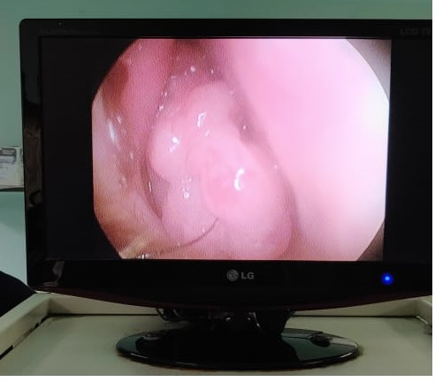
Investigations
Diagnostic Nasal Endoscopy On diagnostic nasal endoscopic examination a pinkish polypoidal mass was seen in the right nasal cavity arising from right middle meatus. Does not bleed on touch.

Slide 9
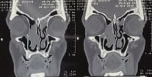
Investigations
CT scan of PNS: A large soft tissue density mass of size approx. 5.3(AP)x 1.7(T) cm is noted in right nasal cavity which is displacing towards left, bilateral ethmoid trabeculae, middle and inferior nasal turbinates, Bilateral superior nasal turbinates, superior portion of medial wall of maxillary sinus, medial portion of maxillary sinus, bilateral lamina papyracia, cribiform plate. It is not causing erosion and destruction of bony nasal septum. There is no extension of mass or any compression on muscles of right orbit or optic nerve. Fat planes are preserved. There is no intracranial extension or erosion of cribiform plate.

Slide 10
Investigations
Biopsy Biopsy from nasal mass was suggestive of Sinonasal papilloma.

Slide 11
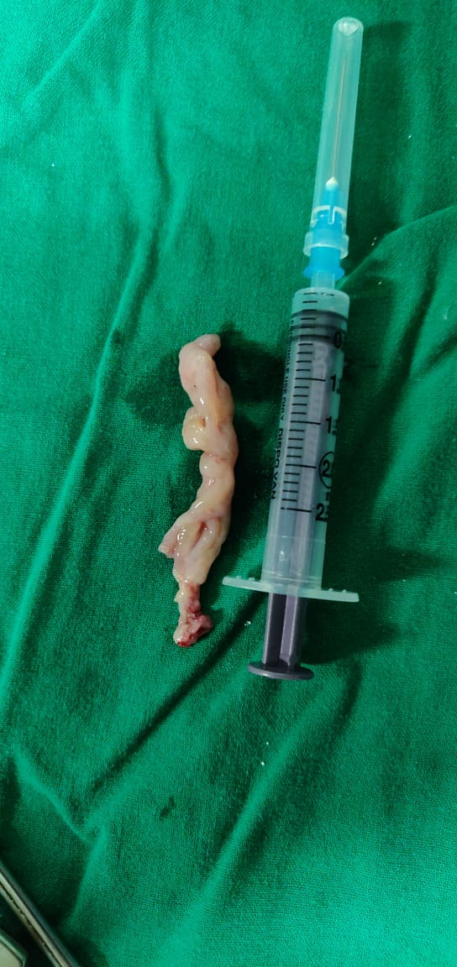
Intraoperative
Endoscopic view of Nasal Mass visualised
Excised mass

Slide 12
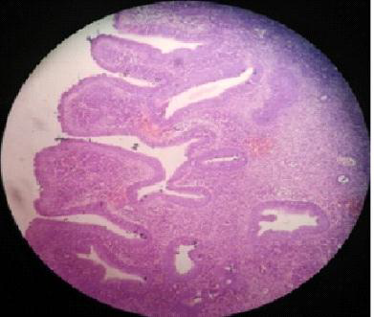
Histopathology
Histopathological report of nasal mass was suggestive of Inverted Papilloma.

Slide 13
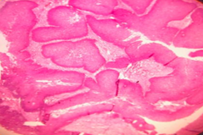
Low power view: This section shows nests of squamous epithelium, arranged in papillary pattern.
Enclosing fibrovascular stroma.

Slide 14
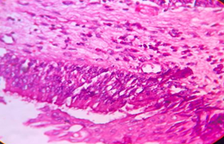
High power view: This section shows psuedostratified ciliated columnar epithelium of nose.
The mass was situated below the nasal mucosa.
Fibrovascular tissue shows scattered inflammatory cells

Slide 15
No atypia, no features of malignancy seen in the sections examined.
Histopathological findings are suggestive of Inverted papilloma of nose.

Slide 16
Discussion
Inverted papilloma also called Schneiderian papilloma or Ringertz tumor .
It is a benign neoplastic growth of superficial epithelium of nasal mucosa.
It is more common in 2nd to 6th decade of life.
Male to female ratio is 3:1.
Incidence of inverted papilloma is 0.6 cases per 100000 people per year and comprises 0.5–4% of all primary nasal tumors.

Slide 17
Discussion
Arises from the lateral nasal wall (middle turbinate or ethmoid recesses), middle meatus, extending into ethmoid and maxillary sinuses.
In advanced cases, extension into all ipsilateral paranasal sinuses may occur.
Intracranial extension or dural penetration is rare.

Slide 18
Discussion
Squamous cell carcinoma is the most common malignant neoplasm associated with inverted papilloma.
Other malignant neoplasm are adenocarcinoma and small cell carcinoma.
Inverted papilloma is caused by HPV 6, 11, 16, 18 and Epstein Barr viruses.
Inverted papilloma has a high rate of recurrence between 0 and 78 percent
Patients with inverted papilloma usually present with nasal obstruction, rhinorrhea, epistaxis, anosmia, nasal mass and headache. Proptosis and facial swelling sometimes develop secondary to expansion of lesion.

Slide 19
Discussion
Krouse staging system
Stage - 1 | Tumor restricted to nasal cavity
Stage - 2 | Tumor restricted to ethmoid sinus and medial portion of the maxillary sinus
Stage - 3 | Tumor involving the lateral or inferior or superior portion of the maxillary sinus or frontal or sphenoid sinuses
Stage - 4 | Tumor beyond nose and paranasal sinus boundaries or malignant disease
Notes:
1. Our patient is In stage 2. 2. thickened squamous epithelial proliferation extend downward into underlying connective tissue stroma to form large clefts, ribbons and islands. Mitotic figure seen in basal and parabasal layers and stromal components vary from myxoid to fibrous, with admixed chronic inflammatory cells and variable vascularity.

Slide 20
Discussion
Radiological features seen in contrast enhanced CT in inverted papilloma include varying degree of bone destruction like thinning, remodeling, erosion, sclerotic bony changes, widening of infundibulum in involvement of maxillary sinus, slight enhancement and calcification.
Biopsy is the diagnostic method of choice. Multiple sections need to be examined to define the initial tumor type as inverted papilloma can be associated with coexisting malignancy. Histopathological examination classically shows inverted growth pattern of stratified squamous epithelium into underlying stroma.
Notes:
1. Our patient is In stage 2. 2. thickened squamous epithelial proliferation extend downward into underlying connective tissue stroma to form large clefts, ribbons and islands. Mitotic figure seen in basal and parabasal layers and stromal components vary from myxoid to fibrous, with admixed chronic inflammatory cells and variable vascularity.

Slide 21
Discussion
Inverted papillomas are effectively managed by surgery.
There are four types of approaches – endoscopic, lateral rhinotomy , midfacial degloving and modified Lothrop.
Endoscopic approach was first tried by Stammberger in 1981. Endoscopic surgery is effective for inverted papilloma restricted to middle nasal meatus, anterior ethmoidal cells and posterior ethmoidal cells, nasofrontal recess or sphenoid sinus.
Notes:
Three goals of adequate surgical procedure are to allow sufficient exposure for complete resection of the tumor, provide an unobstructed view for postoperative surveillance of the cavity and minimize cosmetic deformities and functional disabilities.
Studies by Pasquini et al and Mirza et al showed that recurrence rate was low in endoscopic approach as compared to traditional approaches.20-22

Slide 22
Discussion
Advantages of endoscopic approach:
Superior visualization
Preservation of normal sinonasal physiological function
Achievement of mucocilliary clearance pattern
Lack of an external scar
Shortened hospital stay
Decreased blood loss
Increasing the patient’s quality of life.
Notes:
Three goals of adequate surgical procedure are to allow sufficient exposure for complete resection of the tumor, provide an unobstructed view for postoperative surveillance of the cavity and minimize cosmetic deformities and functional disabilities.
Studies by Pasquini et al and Mirza et al showed that recurrence rate was low in endoscopic approach as compared to traditional approaches.20-22

Slide 23
Discussion
Inverted papilloma has a high rate of recurrence between 0 and 78 percent and recurrence represents residual disease in most cases.
It is imperative to completely excise the tumor with appropriate surgical approach.
Notes:
Three goals of adequate surgical procedure are to allow sufficient exposure for complete resection of the tumor, provide an unobstructed view for postoperative surveillance of the cavity and minimize cosmetic deformities and functional disabilities.
Studies by Pasquini et al and Mirza et al showed that recurrence rate was low in endoscopic approach as compared to traditional approaches.20-22

Slide 24
Thank You!!!

